Slide 1




DSS
DATA STRUCTURE
SIMULATOR
An interactive learning tool
Submitted by
Supervised by
Habibur Rahman Mahin
Dr.Ahmedul Kabir
BSSE-1422
Associate Professor
Institute of Information Technology
Institute of Information Technology
University of Dhaka
University of Dhaka

Slide 2



About DSS
The Data structure Simulator(DSS) provides a visual and interactive learning experience for users .
The simulator aims to help beginners and students gasp the underlying concepts of fundemental data structures.
Stacks, queues, trees, graphs sorting techniques such as bubble sort, insertion sort, merge sort etc are visualized.

Slide 3



Goals
Objective 01
Objective 02
To make data structures easier to understand for the users
To let users visualize how various algorithms actually work

Slide 4






Project Features
01
02
03
04
Interactive
Interface
Step-by-Step
Process
Dynamic
Data Input
Interactive
Manipulation

Slide 5



Interactive Interface
The simulator boasts a user-friendly interface.
Allows users to select and interact with different data structures and algorithms easily.

Slide 6
Step-by-Step Process
The DSS provides a step-by-step demonstration of how each data structure and sorting algorithm works.
Users can follow along with the simulation to undersatnd the data flow and changes at each stage .

Slide 7
Dynamic Data Input
Users have the option to input their data elements.
This flexibility allows them to see first hand how the structure handles different data sets and how sorting algorithms arrange them in real-time.

Slide 8
Interactive Manipulation
DSS allows users to interact with the simulated structure directly.
They can add, remove, or modify elements.
Test various operations,and observe how these actions affect the overall structure.

Slide 9
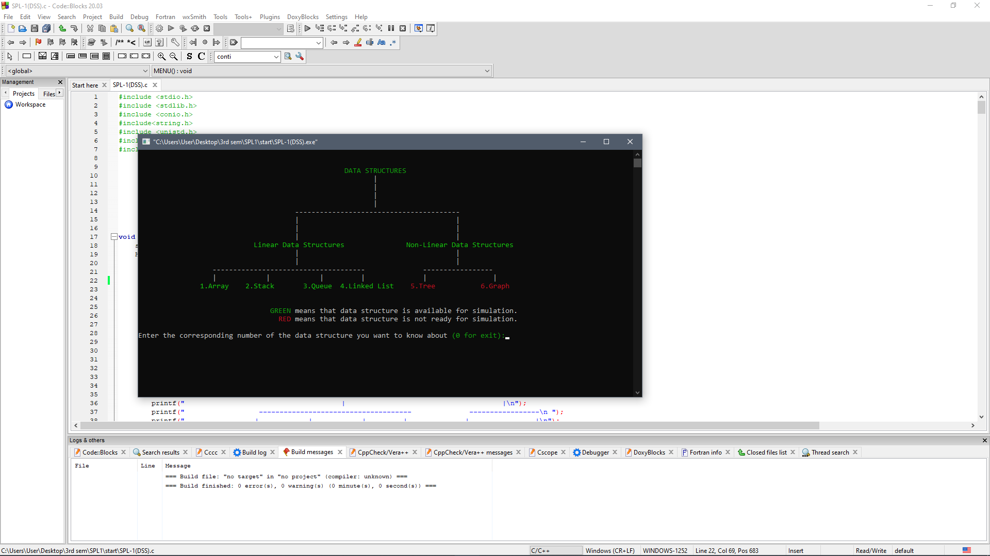
User-friendly
interface

Slide 10
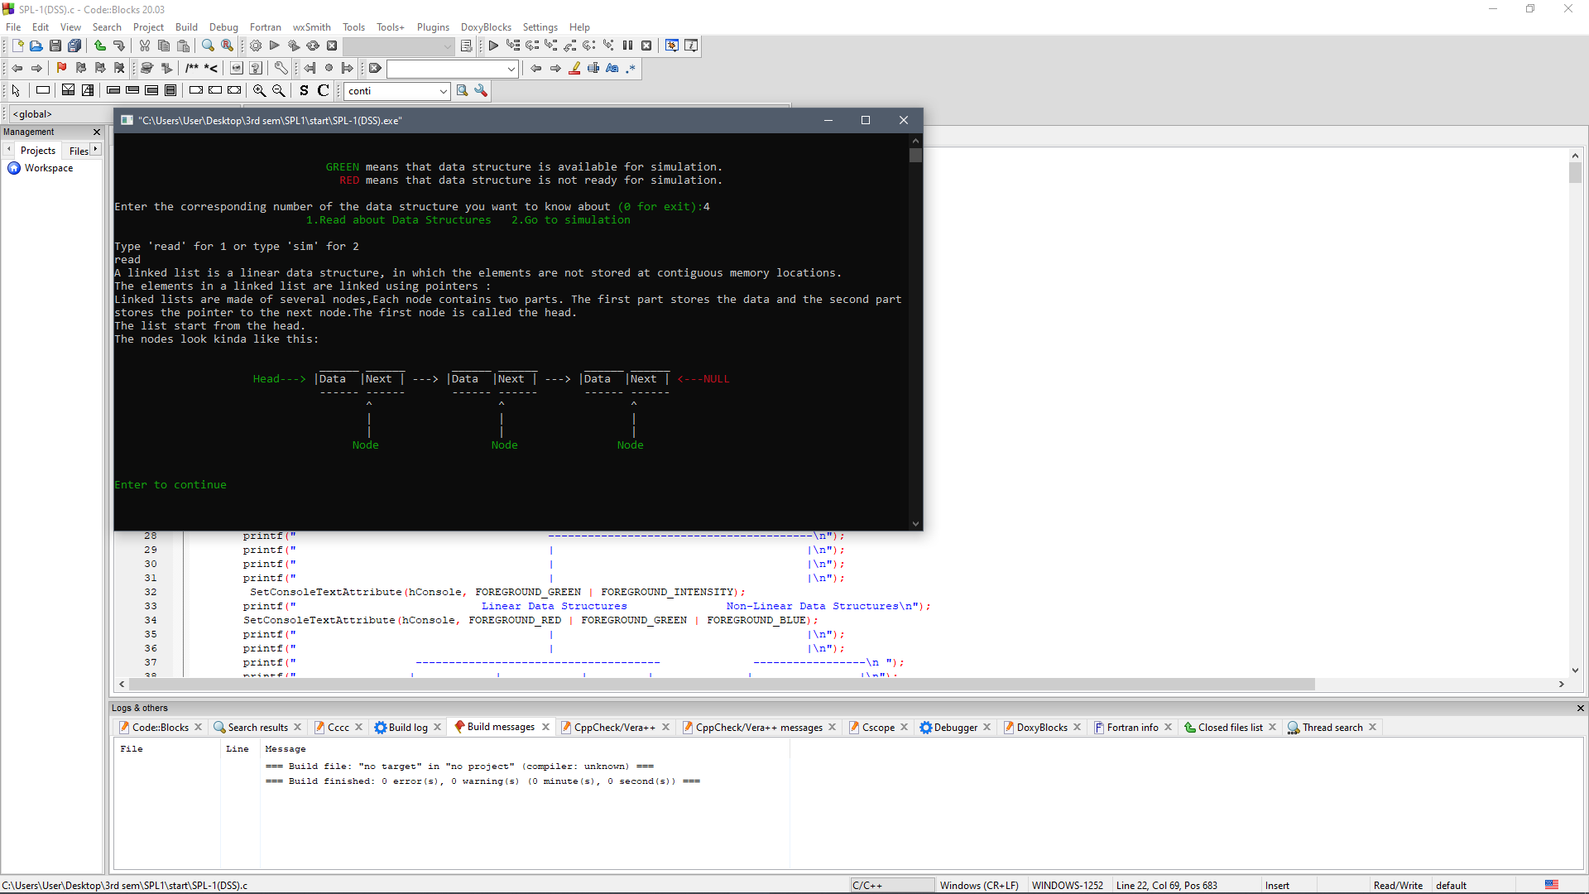
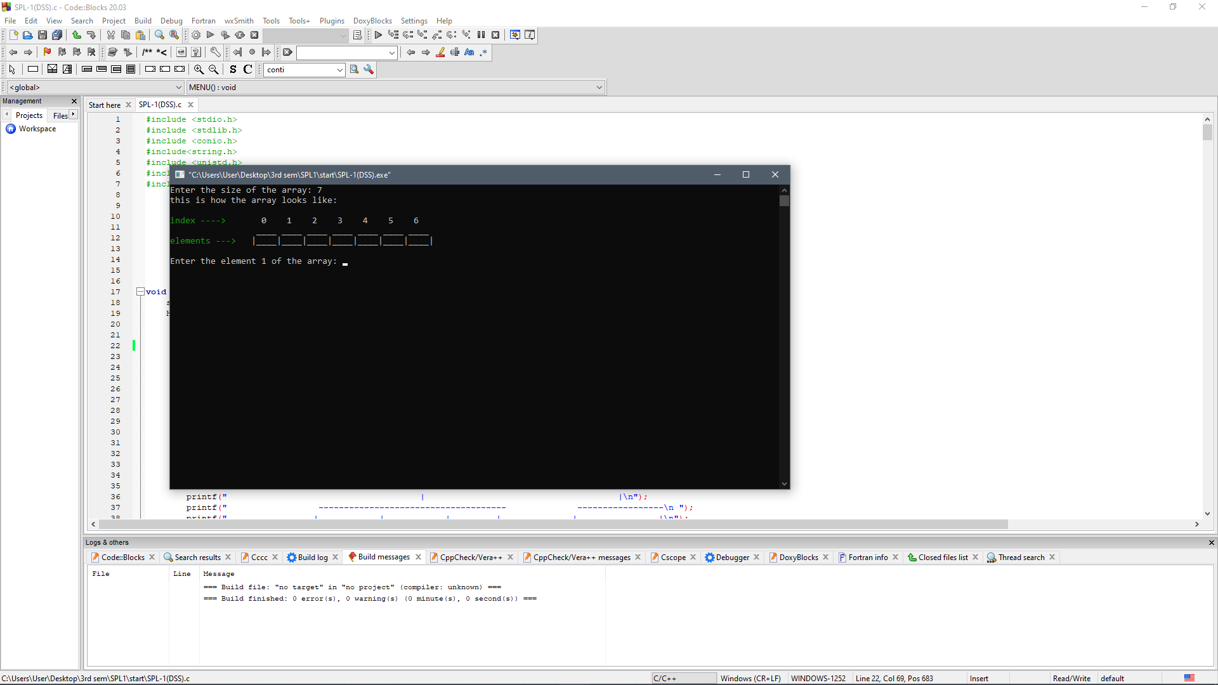
Get visually adapted to different data structures

Slide 11
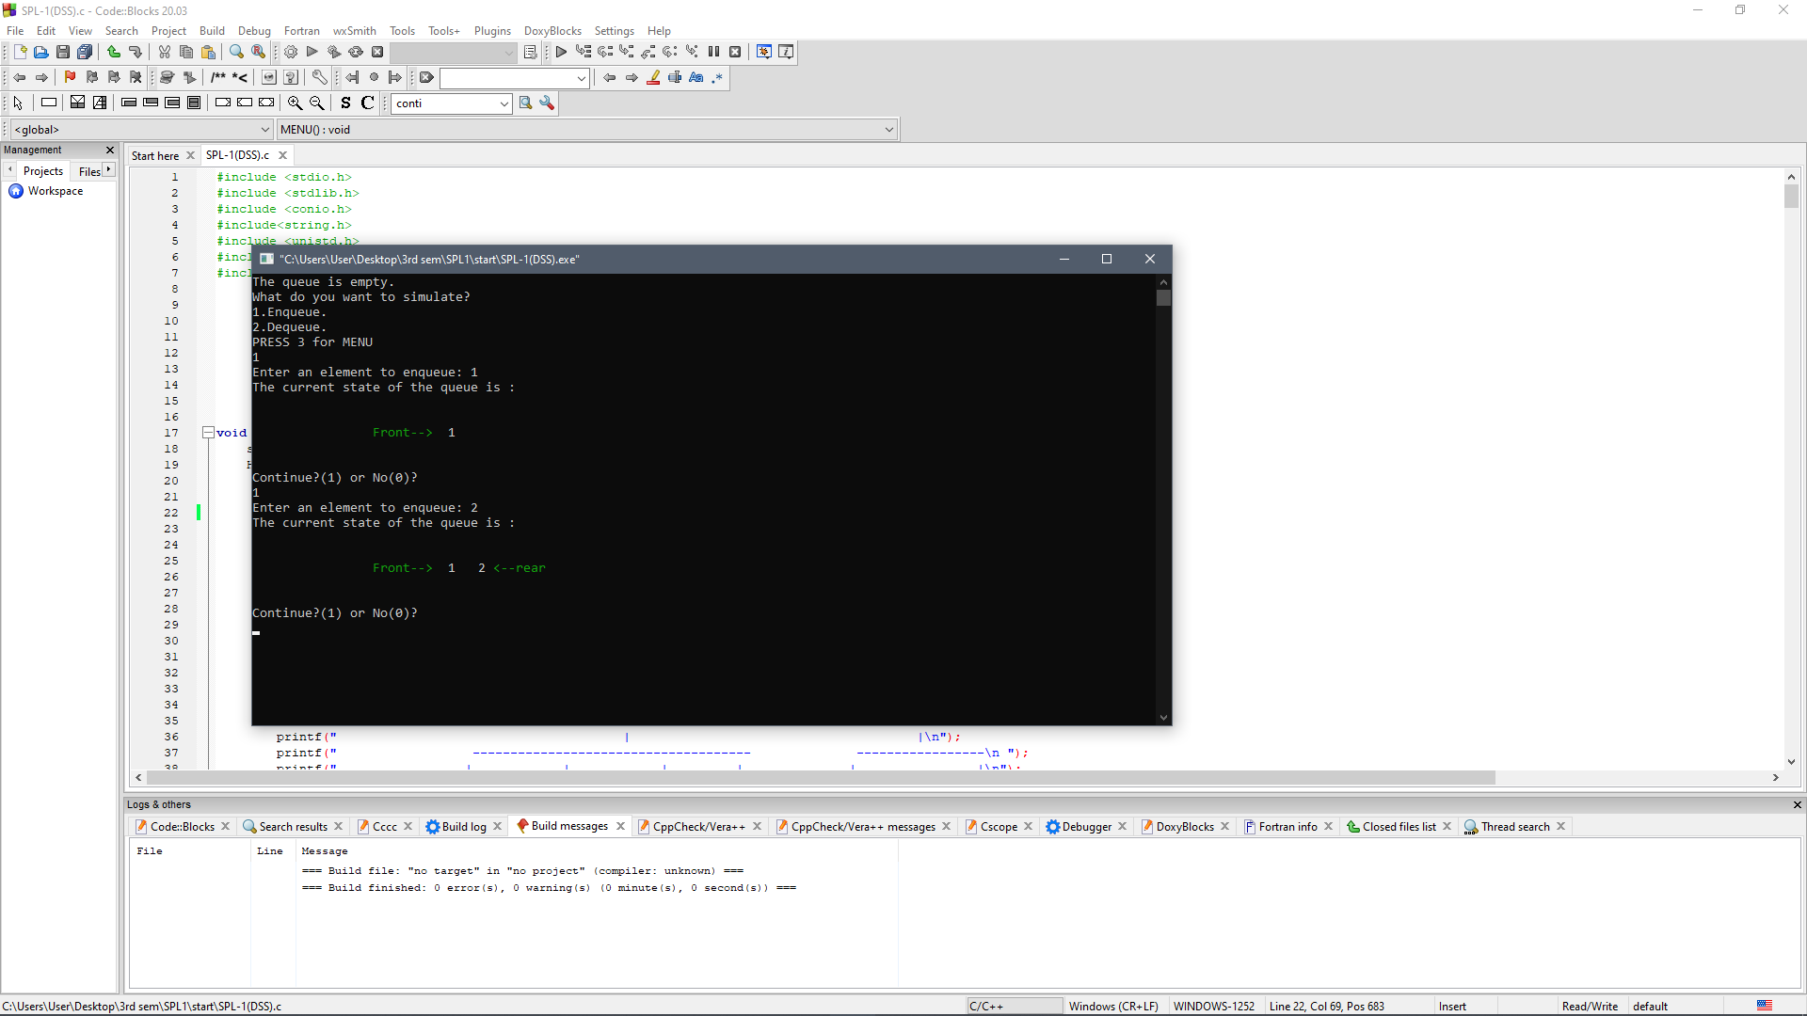
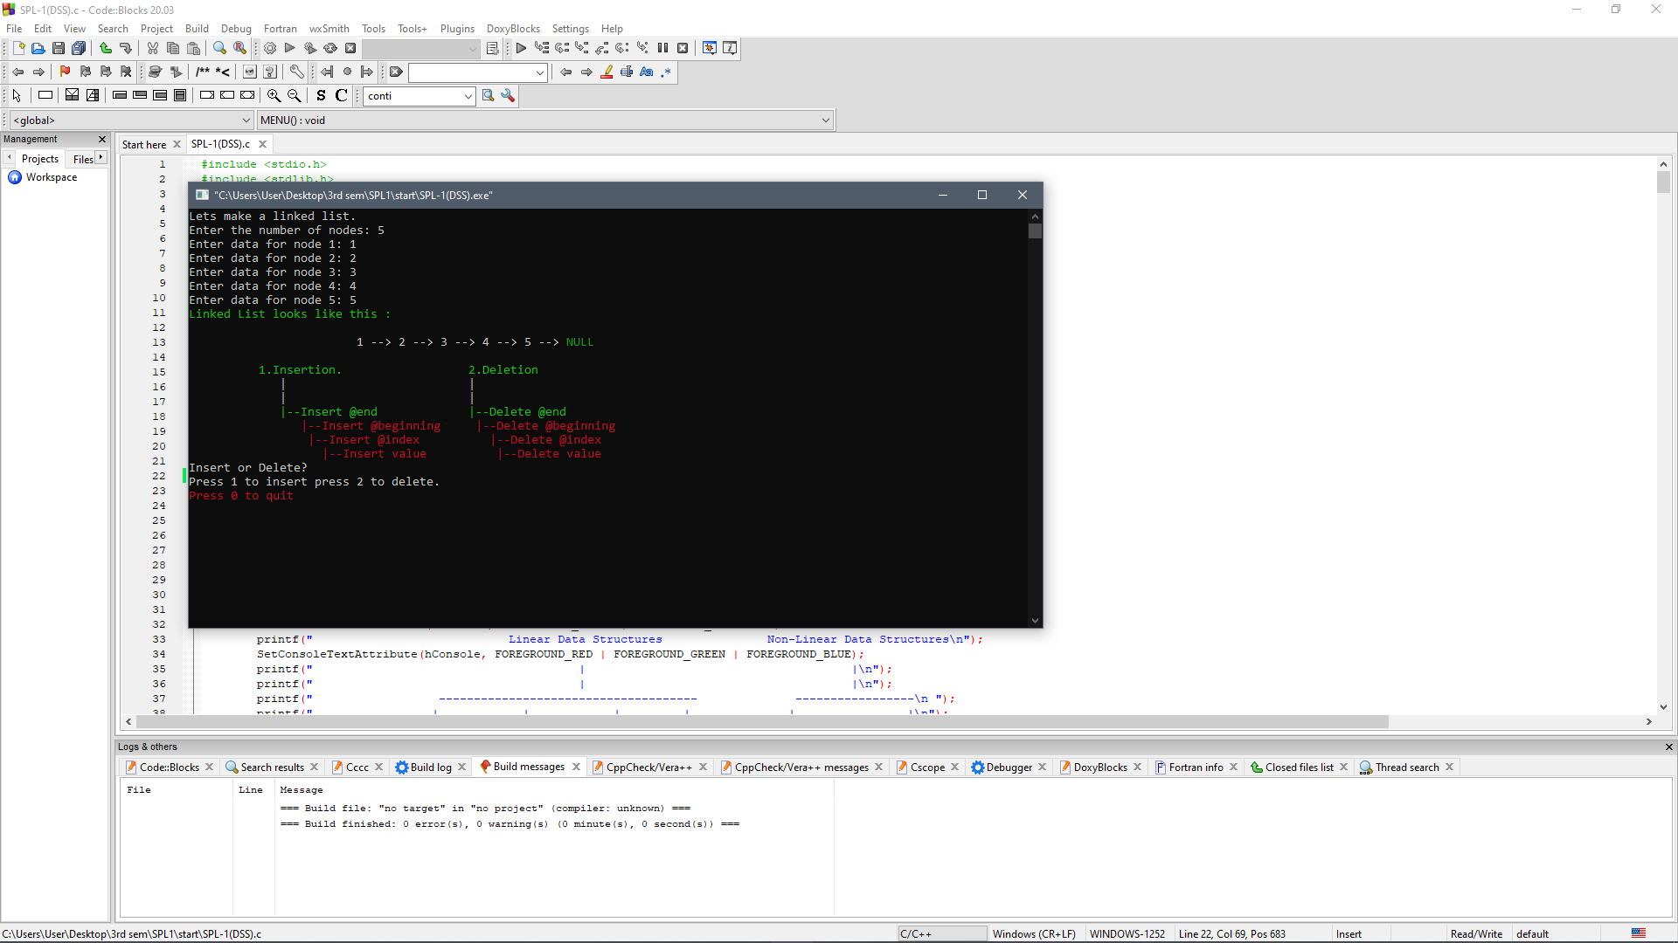
Dynamic inputs and outputs

Slide 12
DSS
THANK YOU
For watching this presentation

